Slide 1


Number Theory
Ms. Swati Mali
swatimali@somaiya.edu
Assistant Professor, Department of Computer Engineering
K. J. Somaiya College of Engineering
Somaiya Vidyavihar University

Slide 2
Number Theory
The goal of every cryptographic scheme is to be "crack proof"
Cryptography is also a means to ensure the integrity and preservation of data from tampering.
Modern cryptographic systems relies highly on functions associated with advanced mathematics, including number theory
Number Theory explores the properties of numbers and the relationships between numbers.

Slide 3
Why?
prime numbers and functions related to prime numbers

Slide 4
Objectives
•To study integer arithmetic, concentrating on divisibility and finding the greatest common divisor using the Euclidean algorithm
•To understand how the extended Euclidean algorithm can be used to solve linear congruent equations, and to find the multiplicative inverses
•To emphasize the importance of modular arithmetic and the modulo operator
•To emphasize and review matrices and operations on residue matrices that are extensively used in cryptography
•To solve a set of congruent equations using residue matrices
Cryptography is based on some specific areas of mathematics, including number theory, linear algebra, and algebraic structures.

Slide 5
INTEGER ARITHMETIC
•Concept of set and a few operations.
•Set of Integers
•Binary Operations
•Integer Division
•Divisibility
–Euclidean Algorithm
–The Extended Euclidean Algorithm

Slide 6
Set of Integers
•Set of Integers
The set of integers contains all integral numbers (with no fraction) from negative infinity to positive infinity
Z = { . . . , −2, −1, 0, 1, 2, . . . }

Slide 7
Binary Operations
•Three binary operations applied to the set of integers : addition, subtraction, and multiplication, division
• A binary operation takes two inputs and creates one output.
•Each operations takes two inputs (a and b) and creates one output (c)
•The two inputs come from the set of integers; the output goes into the set of integers

Slide 8
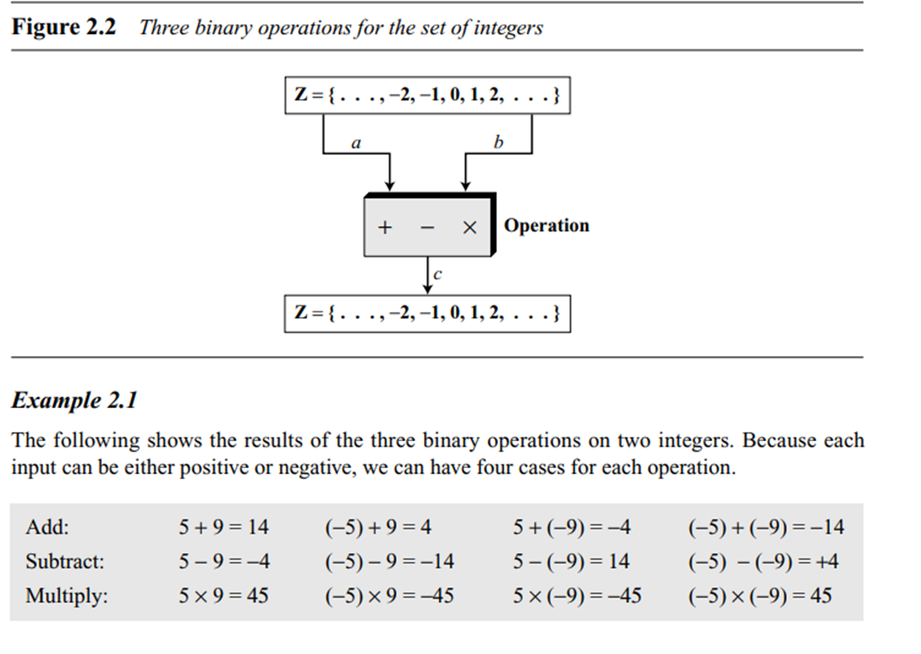
Binary Operations

Slide 9
Integer Division
•The division produces two outputs instead of one: Quotient and Remainder
•The operation a ÷ n gives q and r.
•The relationship between these four integers:
a = q × n + r
• a => dividend;
•Q => quotient;
•N => divisor
•R => remainder.
•Division is not taken as an operation, because the result of dividing a by n is two integers, q and r.
•It is taken as division relation

Slide 10
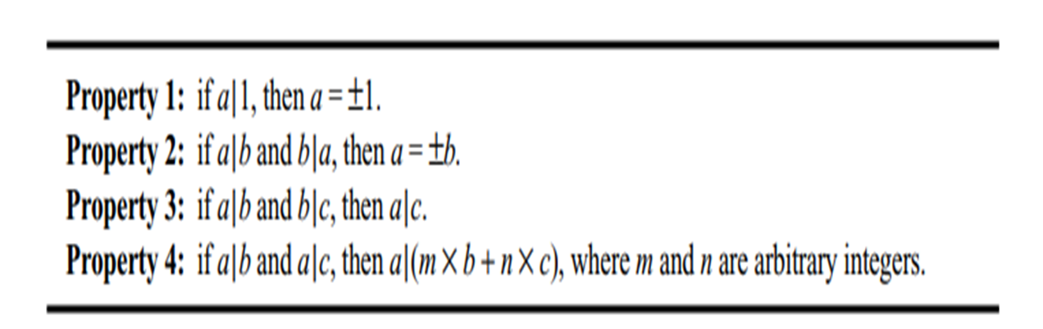
Divisibility
•Depends on if r=0 in the division relation
•a|n if a is divisible by n
•a∤ n otherwise

Slide 11
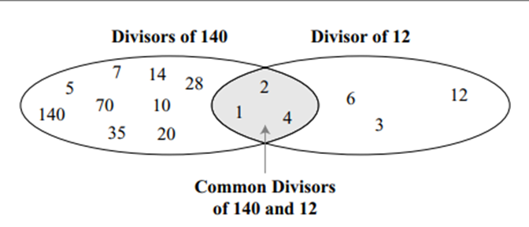
Greatest Common Divisor
•Two positive integers may have many common divisors, but only one greatest common divisor.
•E.g. the common divisors of 12 and 140 are 1, 2, and 4. However, the greatest common divisor is 4.
•The greatest common divisor of two positive integers is the largest integer that can divide both integers.
•

Slide 12
MODULAR ARITHMETIC
•The modular arithmetic is interested in only one of the outputs, the remainder r.
•The quotient q is not significant
•Mod=modulo operator
•a mod n ⇒ The second input (n) is called the modulus.
•r= a mod n ⇒ The output r is called the residue.

Slide 13
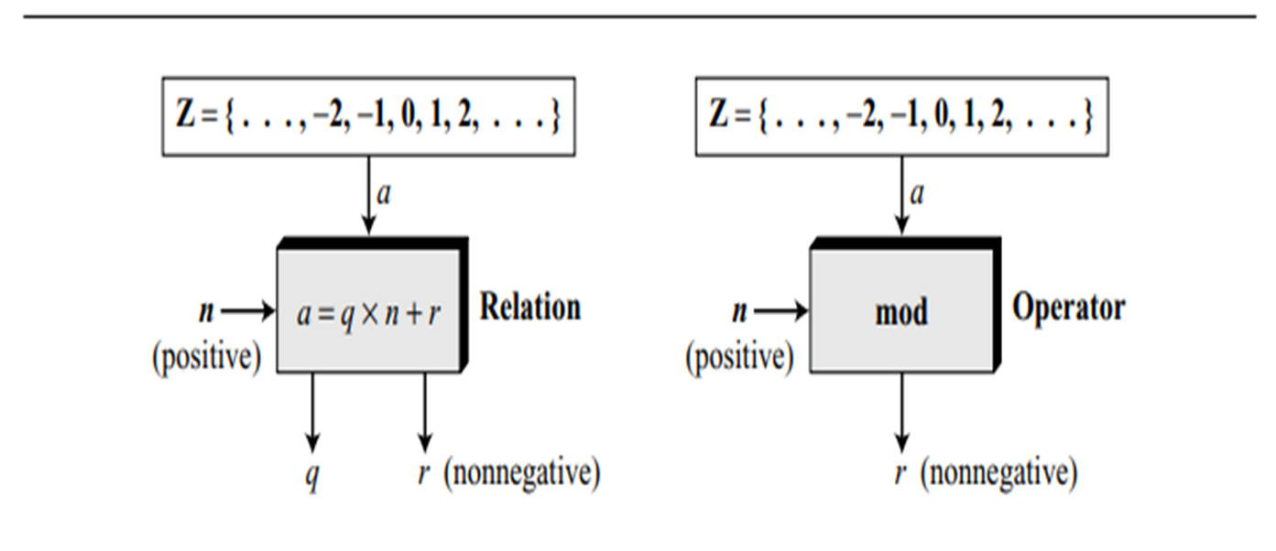
Division relation and modulo operator

Slide 14
Set of Residues: Zn
•The result of the modulo operation with modulus n is always an integer between 0 and n − 1.
•i.e. result of a mod n is always a nonnegative integer < n.
•i.e. modulo operation creates a set, referred to as the set of least residues modulo n, or Z_{n}.
Zn = { 0, 1, 2, 3, . . . , (n − 1) }
• Z₂ = { 0, 1 }
•Z₆ = { 0, 1, 2, 3, 4, 5 }
•Z₁₁ = { 0, 1, 2, 3, 4, 5, 6, 7, 8, 9, 10 }

Slide 15
Congruence
•Cryptography uses the concept of congruence instead of equality.
•Mapping from Z to Z_{n} is not one-to-one.
•Infinite members of Z can map to one member of Z_{n}.
•E.g. , 2 mod 10 = 2, 12 mod 10 = 2, 22 mod 2 = 2, and so on.
•Hence in modular arithmetic, integers like 2, 12, and 22 are called congruent mod 10.
•Denoted with congruence operator (≡).
•2 ≡ 12 (mod 10), 13 ≡ 23 (mod 10), 34 ≡ 24 (mod 10),
•−8 ≡ 12 (mod 10), 3 ≡ 8 (mod 5), 8 ≡ 13 (mod 5),
23 ≡ 33 (mod 5), −8 ≡ 2 (mod 5)

Slide 16
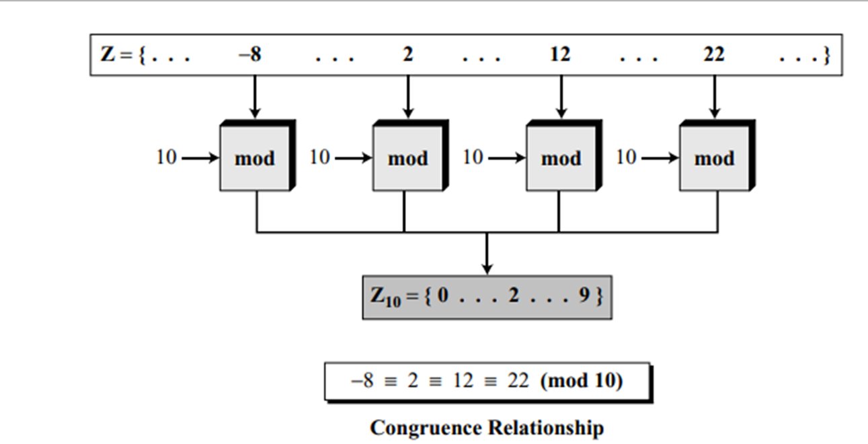

Slide 17
A residue class
•A residue class [a] or [a]n is the set of integers congruent modulo n.
•i.e. the set of all integers x such that
x = a (mod n).
•E.g. n = 5, gives five sets [0], [1], [2], [3], and [4] as :
•[0] = {…, −15, −10, −5, 0, 5, 10, 15, …}
•[1] = {…, −14, −9, −4, 1, 6, 11, 16, …}
•[2] = {…, −13, −8, −3, 2, 7, 12, 17, …}
•[3] = {…, −12, −7, −5, 3, 8, 13, 18, …}
•[4] = {…, −11, −6, −1, 4, 9, 14, 19, …}
•The set of all of these least residues: Z₅ = {0, 1, 2, 3, 4}.
•i.e, the set Z_{n} is the set of all least residue modulo n.

Slide 18
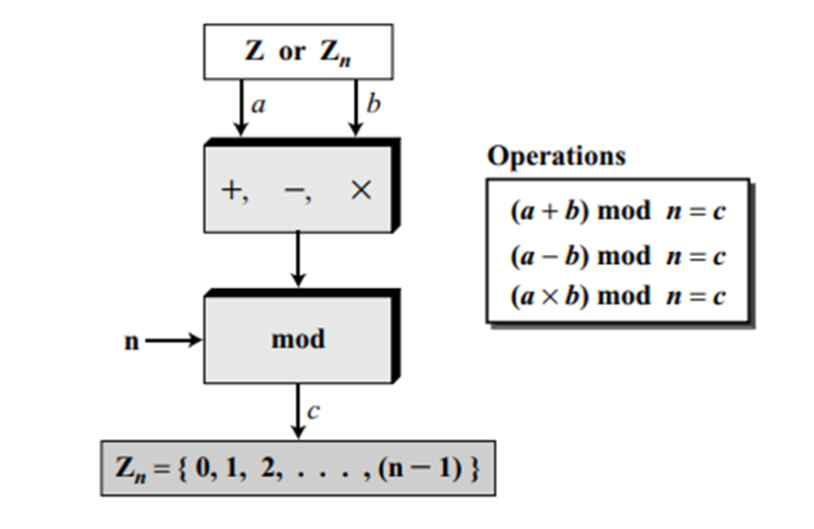
Operations in Z_{n}
•Addition, subtraction, and multiplication can also be defined for the set Zn.

Slide 19
Inverses
•modular arithmetic often needs to find the inverse of a number relative to an operation.
•Types:
–additive inverse (relative to an addition operation) or
–a multiplicative inverse (relative to a multiplication

Slide 20
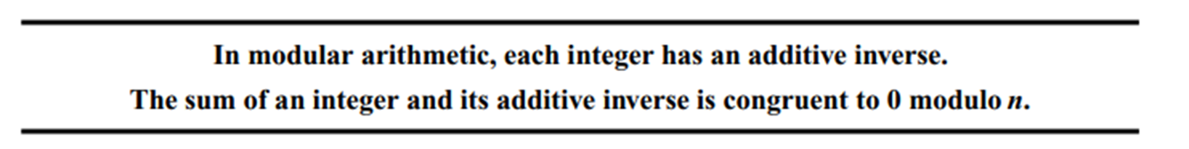
Additive Inverse In Z_{n}
•In Z_{n}, two numbers a and b are additive inverses of each other if
a + b ≡ 0 (mod n)
•The additive inverse of a can be calculated as
b = n − a.
•E.g. the additive inverse of 4 in Z₁₀ is 10 − 4 = 6.

Slide 21
•Find all additive inverse pairs in Z₁₀
Solution: The six pairs of additive inverses are :
(0, 0), (1, 9), (2, 8), (3, 7), (4, 6), and (5, 5).
•0 is the additive inverse of itself; so is 5.
•Note : the additive inverses are reciprocal;
–E.g. if 4 is the additive inverse of 6, then 6 is also the additive inverse of 4.

Slide 22
Additive inverse of –ve number
• Formula : -n mod k ≡ k - (n mod k)
•e.g. -3 mod 12 = 12 - (3 mod 12) = 12 -3 = 9
•-34 mod 23 = 23 - (34 mod 23) = 23 - 11 = 12
•
Hint: if n < k, compute k-n
•else take multiple of k which is just greater than n, subtract n from that multiple
•e.g. 23 * 2 = 46 > n=34 ⇒ 46-34 = 12
•

Slide 23
Example operations over Z_{n}
1.Add 7 to 14 in Z₁₅.
Solution: (14 + 7) mod 15 → (21) mod 15 = 6
2.Subtract 11 from 7 in Z₁₃.
(7 − 11) mod 13 → (−4) mod 13 = 9 (Additive inverse)
3. Multiply 11 by 7 in Z20
(7 × 11) mod 20 → (77) mod 20 = 17

Slide 24
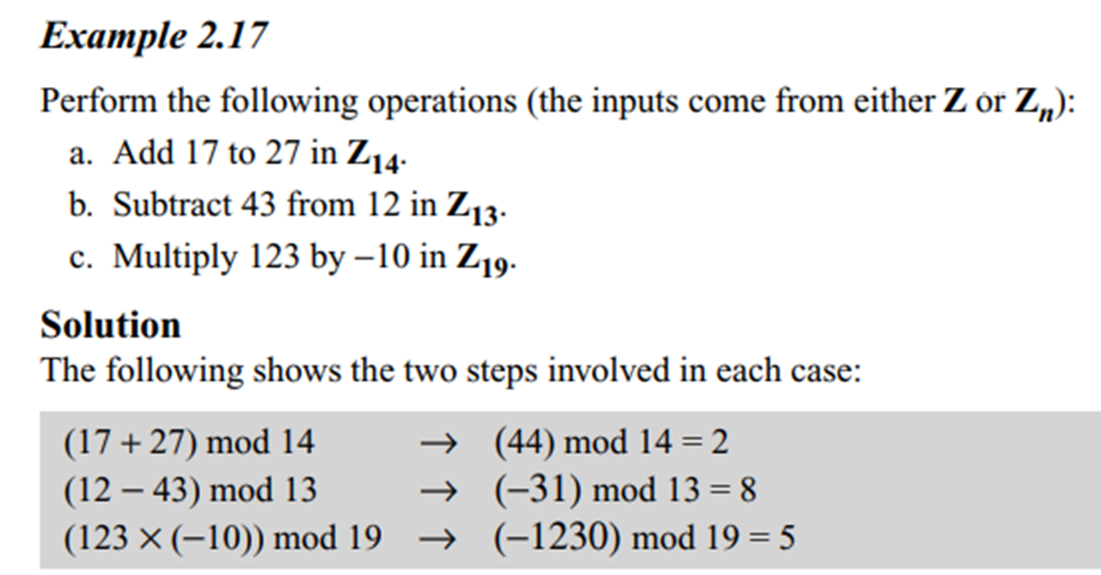
Example operations over Zn

Slide 25
Addition and Multiplication In cryptography
If the sender uses an integer (as the encryption key), the receiver uses the inverse of that integer (as the decryption key).
If the cryptographic operation is addition, Zn gives set of an additive inverse.
if the operation is multiplication, Zn* gives multiplicative inverse

Slide 26
Use Z_{n} for additive inverses
use Z_{n*} when multiplicative inverses are needed.
Z₆ = {0, 1, 2, 3, 4, 5} Z_{6 *} = {1, 5}
Z₇ = {0, 1, 2, 3, 4, 5, 6} Z_{7 *} = {1, 2, 3, 4, 5, 6}
Z₁₀ = {0, 1, 2, 3, 4, 5, 6, 7, 8, 9} Z_{10*} = {1, 3, 7, 9}

Slide 27
Zp and Zp* sets
The modulus in Zp and Zp* sets is a prime number.
a prime number has only two divisors: integer 1 and itself.
The set Zp is the same as Zn except that n is a prime. i.e. Zp contains all integers from 0 to p − 1.
Each member in Zp has an additive inverse;
each member except 0 has a multiplicative inverse.

Slide 28
Zp and Zp* sets
The set Zp* is the same as Zn* except that n is a prime.
Zp* contains all integers from 1 to p − 1.
Each member in Zp* has an additive and a multiplicative inverse.
Zp* is a very good candidate when we need a set that supports both additive and multiplicative inverse.

Slide 29
Zp and Zp* set examples
Z₁₃ = {0, 1, 2, 3, 4, 5, 6, 7, 8, 9, 10, 11, 12}
Z₁₃∗ = {1, 2, 3, 4, 5, 6, 7, 8, 9, 10, 11, 12}

Slide 30
Multiplicative Inverse
•In Zn, two numbers a and b are the multiplicative inverse of each other if
a × b ≡ 1 (mod n)
•E.g. , if the modulus is 10, then the multiplicative inverse of 3 is 7.
– i.e. (3 × 7) mod 10 = 1.
•a has a multiplicative inverse in Zn
iff gcd (n, a) = 1. i.e, a and n are relatively prime.

Slide 31
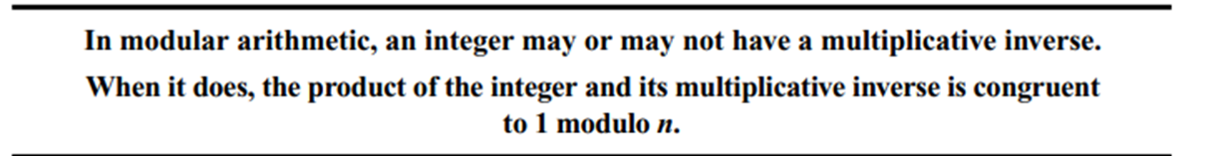
Multiplicative Inverse

Slide 32
Multiplicative inverse
Given two integers a and m, find the modular multiplicative inverse of a under modulo m.
The modular multiplicative inverse is an integer X such that:
a*x ≡ 1 (mod m)
If a=3, m=11 then x= 4 , 3 and 4 are called multiplicative inverses of each other modulo 11
Modular multiplicative inverse when M and A are coprime i.e. gcd(a, m)=1

Slide 33
Example
Find 4⁻¹ mod 23
So 4* x = 1 (mod 23)
4* 1 = 4 mod 23 = 4
4*2 = 8 mod 23 = 8
4*3 =12 mod 23 =12
4*4 =16 mod 23 = 16
4*5 = 20 mod 23 =20
4*6 = 24 mod 23 =1
So 4 & 6 are modulo inverses of each other modulo 23

Slide 34
Examples
•Find the multiplicative inverse of 8 in Z₁₀.
Solution:
There is no multiplicative inverse because
gcd (10, 8) = 2 ≠ 1.
i.e. there exist no number between 0 and 9 such that when multiplied by 8, the result is congruent to 1.

Slide 35
Examples
•Find all multiplicative inverses in Z₁₀.
Solution : (1, 1), (3, 7) and (9, 9).
The numbers 0, 2, 4, 5, 6, and 8 do not have a multiplicative inverse.

Slide 36
Examples
•Find all multiplicative inverse pairs in Z₁₁. Solution: (1, 1), (2, 6), (3, 4), (5, 9), (7, 8), (9, 9), and (10, 10).
•In Z₁₁, gcd (11, a) is 1 (relatively prime) for all values of a except 0.
•It means all integers 1 to 10 have multiplicative inverses

Slide 37
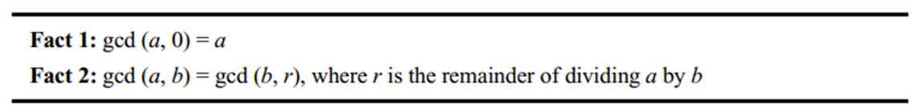
Euclidean Algorithm
•Finding gcd of two positive integers by listing all common divisors is not practical when the two integers are large.
•Euclid(BC 300) developed an algorithm to find the GCD of two positive integers.

Slide 38
Euclidean Algorithm
•Fact 1: if the second integer is 0, the greatest common divisor is the first one.
•Fact 2: allows us to change the value of a, b until b becomes 0
•E.g. calculate gcd (36, 10). (use the second fact several times)
gcd (36, 10) = gcd (10, 6) = gcd (6, 4) = gcd (4, 2) = gcd (2, 0) = 2

Slide 39
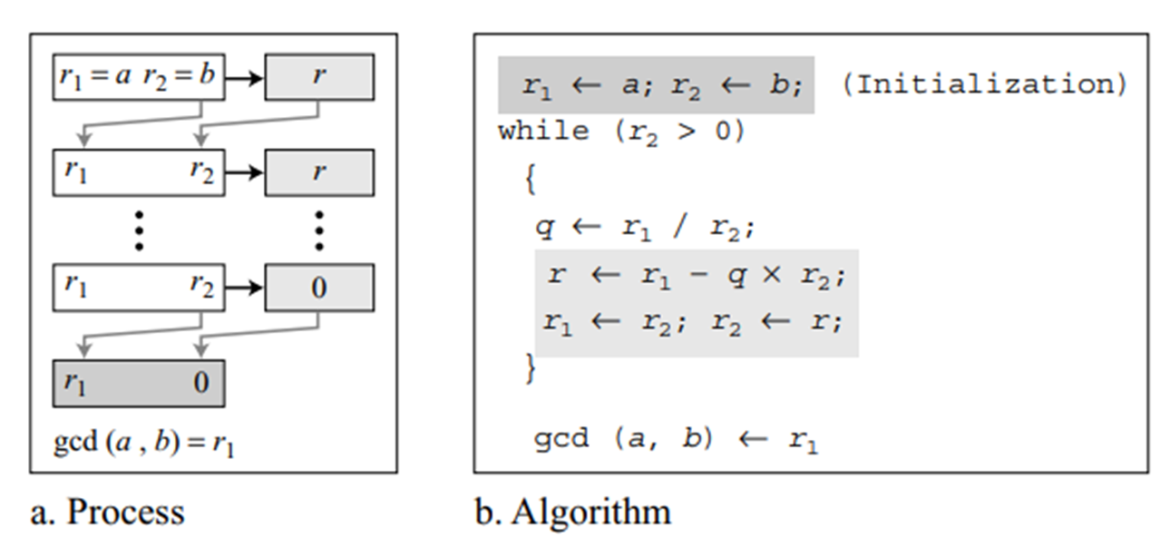
Euclidean Algorithm
•When gcd (a, b) = 1, a and b are termed as relatively prime.

Slide 40
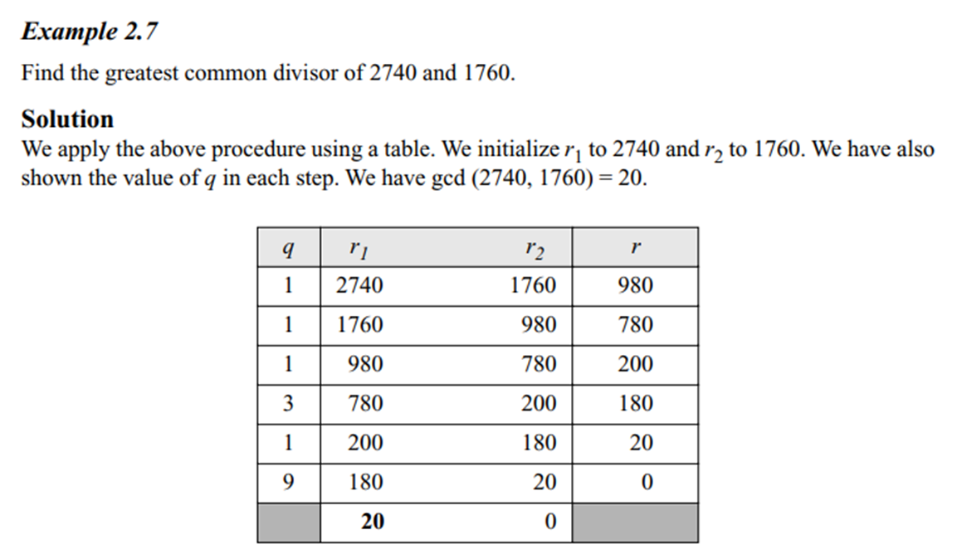
Euclidean Algorithm

Slide 41
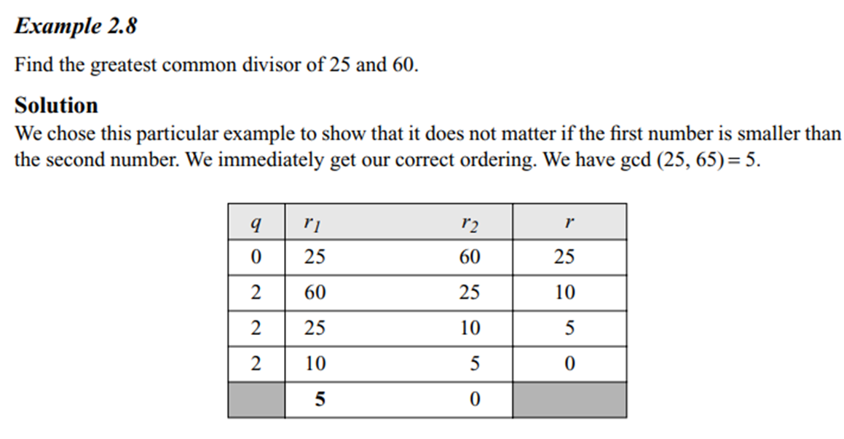
The Euclidean Algorithm

Slide 42
The Extended Euclidean Algorithm
•Given two integers a and b, the extended Euclidean algorithm helps to find other two integers, s and t, such that
s × a + t × b = gcd (a, b)
•The extended Euclidean algorithm can calculate the gcd (a, b) and at the same time calculate the value of s and t.
•Used extensively in computing multiplicative inverses in simple algebraic field extensions.

Slide 43
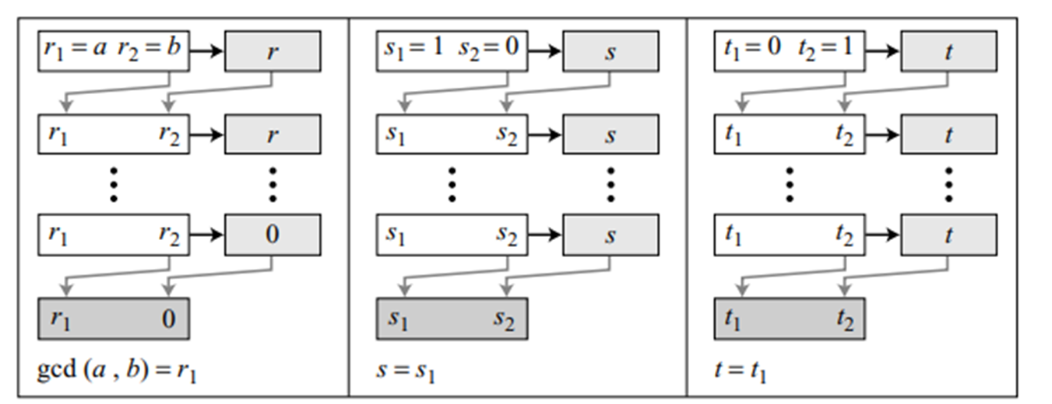
Extended Euclidean Algorithm to find GCD

Slide 44
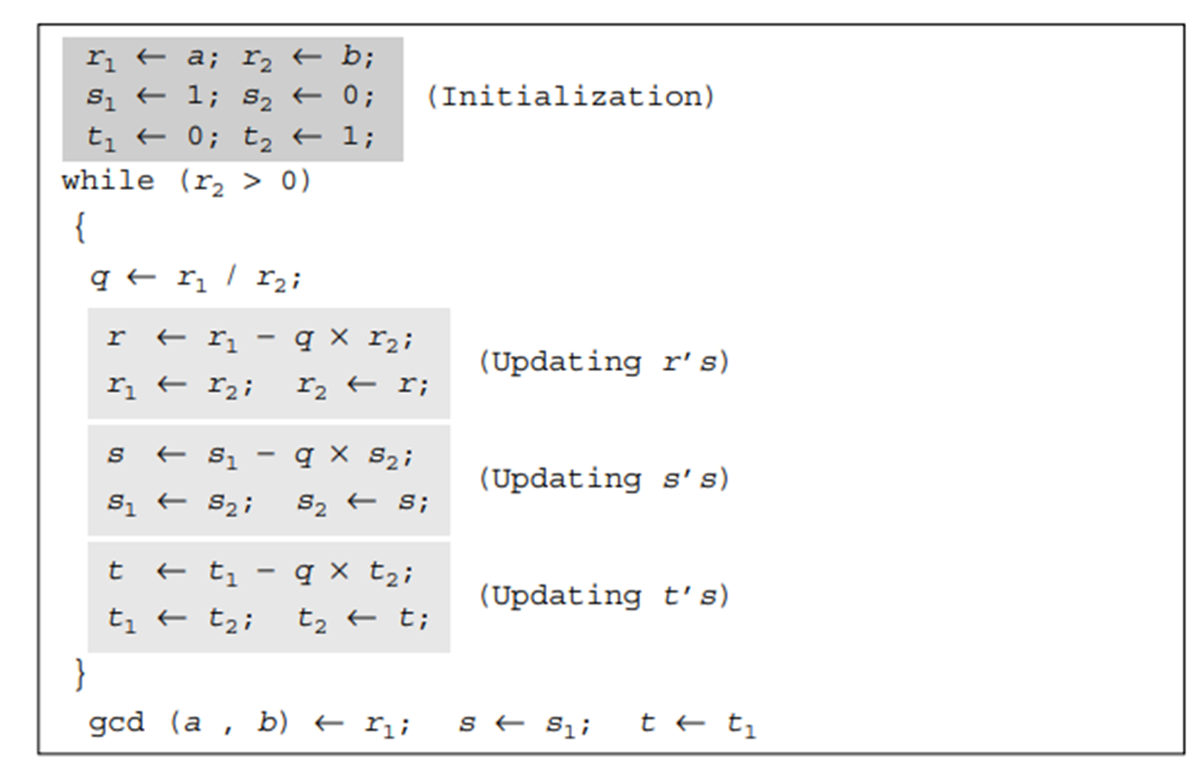
Extended Euclidean Algorithm

Slide 45
Extended Euclidean Algorithm Examples
••Given a = 161 and b = 28, find gcd (a, b). •GCD(161,28)=7
Q=r1/r2 | R1 | R2 | R | s1 | s2 | s= s1 − q × s2 | T1 | T2 | T=t1 − q × t2
5 | 161 | 28 | 21 | 1 | 0 | 1 | 0 | 1 | -5
1 | 28 | 21 | 7 | 0 | 1 | -1 | 1 | -5 | 6
3 | 21 | 7 | 0 | 1 | -1 | 4 | -5 | 6 | -23
 | 7 | 0 |  | -1 | 4 |  | 6 | -23 | 6

Slide 46
Solve using Extended Euclidean Algorithm
Find the greatest common divisor (GCD) of 120 and 23
Find the greatest common divisor (GCD) of 1071 and 462
Compute GCD(25,18)
Compute GCD(56,98)

Slide 47
(GCD) of 120 and 23
Multiplicative inverse of 23 modulo 120 is 47.
Q | A | B | R | S1 | S2 | S= S1-Q*S2 | T1 | T2 | T=T1-Q*T2
5 | 120 | 23 | 5 | 1 | 0 | 1 | 0 | 1 | -5
4 | 23 | 5 | 3 | 0 | 1 | -4 | 1 | -5 | 21
1 | 5 | 3 | 2 | 1 | -4 | 5 | -5 | 21 | -26
1 | 3 | 2 | 1 | -4 | 5 | -9 | 21 | -26 | 47
2 | 2 | 1 | 0 | 5 | -9 | 23 | -26 | 47 | -120
 | 1 | 0 |  | -9 | 23 |  | 47 | -120

Slide 48
Compute GCD(25,18)
multiplicative inverse of 18 modulo 25 is 7.
Q | A | B | R | t1 | t2 | t3
1 | 25 | 18 | 7 | 0 | 1 | -1
2 | 18 | 7 | 4 | 1 | -1 | 3
1 | 7 | 4 | 3 | -1 | 3 | -4
1 | 4 | 3 | 1 | 3 | -4 | 7
3 | 3 | 1 | 0 | -4 | 7 | -25
 | 1 | 0 |  | 7 | -25

Slide 49
GCD(25,18)
GCD(25,18)=1, multiplicative inverse of 18 modulo 25 is 7.
Q | A | B | R | t1 | t2 | t3
1 | 25 | 18 | 7 | 0 | 1 | -1
2 | 18 | 7 | 4 | 1 | -1 | 3
1 | 7 | 4 | 3 | -1 | 3 | -4
1 | 4 | 3 | 1 | 3 | -4 | 7
3 | 3 | 1 | 0 | -4 | 7 | -25
 | 1 | 0 |  | 7 | -25

Slide 50
GCD(56,98)

Slide 51
Extended Euclidean algorithm and inverse
•The extended Euclidean algorithm finds the multiplicative inverses of b in Z_{n} when n and b are given and gcd (n, b) = 1.
•The multiplicative inverse of b is the value of t after being mapped to Z_{n}.

Slide 52
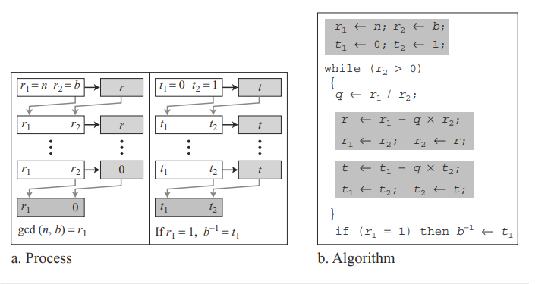
Extended Euclidean Algorithm to compute multiplicative inverse

Slide 53
Find multiplicative inverse using Extended Euclidean algorithm
Q=A/B | A | B | R= A % B | T1 | T2 | T= T1-Q*T2
 |  |  |  | 0 | 1
A > B
Q=A/B
R= A%B
T1=0, T2 =1 T= T1-Q*T2
A=B
B=R
T1=T2
T2=T

Slide 54
Find the multiplicative inverse of 11 in Z₂₆
Q=r1/r2 | r1 | r2 | R | T1 | T2 | T=t1 − q × t2
2 | 26 | 11 | 4 | 0 | 1 | -2
2 | 11 | 4 | 3 | 1 | -2 | 5
1 | 4 | 3 | 1 | -2 | 5 | -7
3 | 3 | 1 | 0 | 5 | -7 | 26
 | 1 | 0 |  | -7 | 26
GCD(26,11)=1, i.e. multiplicative inverse exists
Multiplicative inverse = T1= -7 = 26-7= 19

Slide 55
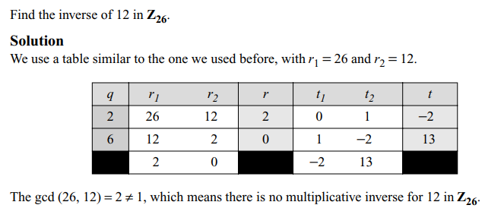

Slide 56
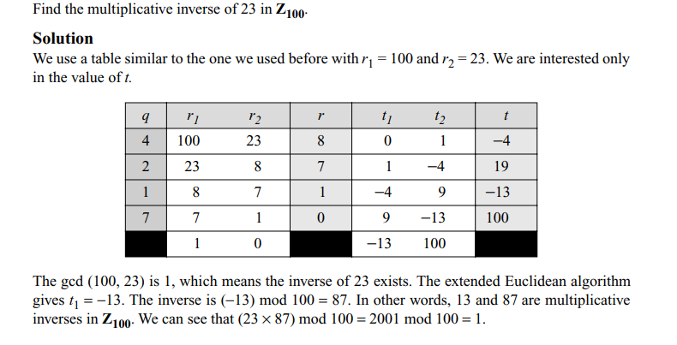

Slide 57
Applications of linear Congruence

Slide 58
Using the Extended Euclidean algorithm, find the greatest common divisor of:
88 and 220
300 and 42
24 and 320
401 and 700
Find the results of the following operations.
22 mod 7
140 mod 10
−78 mod 13
0 mod 15

Slide 59
Find the multiplicative inverse of each of the following integers in Z180 using the extended Euclidean algorithm.
38
7
132
24
Find Zp & Zp* for p= :
589
17
21
7

Slide 60
Mathematics of asymmetric key cryptography

Slide 61
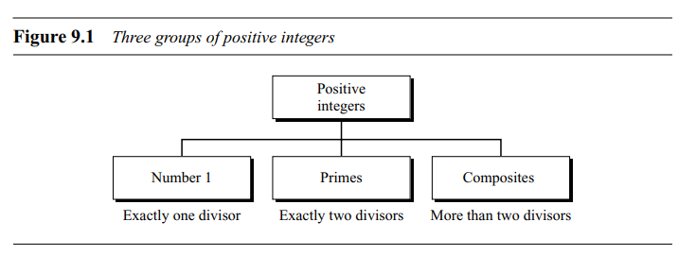
Primes
The positive integers can be divided into three groups: the number 1, primes, and composites
A positive integer is a prime iff it is exactly divisible by two integers, 1 and itself.
A composite is a positive integer with more than two divisors.

Slide 62
Coprimes
Two positive integers, a and b, are relatively prime, or coprime, if gcd (a, b) = 1.
Number 1 is relatively prime with any integer.
If p is a prime, then all integers 1 to p − 1 are relatively prime to p.
There is an infinite number of primes

Slide 63
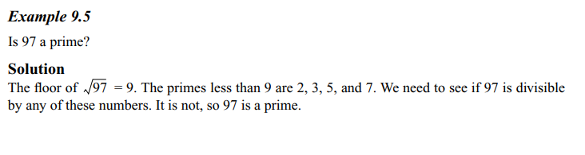
Checking for Primality
Given a number n, if the number is divisible by all primes less than sqrt(n) then it’s a prime number

Slide 64
Algorithms
Euler’s totient/ phi function
Prime number generation
Sieve of Eratosthenes
Sieve of Atkin
Segmented Sieve
Primality testing
Miller-Rabin, Fermat’s test, square root test – Probabilistic
AKS(Agrawal, Kayal, and Saxena) algorithm - deterministic
Prime factorization
Trial division method
Pollard’s Rho
Pollard p – 1 Method
Fermat’s method

Slide 65
Euler’s Phi-Function
AKA Euler’s totient function
Ф(1) = 0.
Ф(p) = (p − 1) if p is a prime
Ф(m × n) = Ф(m) × Ф(n) if m and n are relatively prime.
Ф(p^{e} ) = p^{e} − p^{e−1} if p is a prime
The difficulty of finding Ф(n) depends on the difficulty of finding the factorization of n.

Slide 66
Euler’s ‘ Φ’ Function
An arithmetic function Euler’s Totient function ‘Φ’ is defined as
Φ (n) = number of positive integers less than or equal to n and co-prime with n
i.e. Φ (n) = number of positive integers ‘ a ’ such that 1<= a <= n and GCD(a,n)=1
Φ (15)= 8 as primes relative to 15 are given by 1, 2, 4, 7, 8, 11, 13, and 14.
Φ(7)=6, Φ(17)=16
Φ(m*n)= Φ(m)* Φ(n) where m and n are relatively prime

Slide 67
Why prime numbers?
Primes are foundational in:
Hard mathematical problems (factoring, discrete logs)
Strong, well-understood security foundations
Efficient algorithms in modular arithmetic
Predictable group properties for encryption/signing
Using primes ensures the modulus has fewer factors, which:
Prevents certain factorization shortcuts
Increases resistance to attacks like Pollard’s rho or trial division
Increase Randomness and Unpredictability
Give Mathematical Proof of Security
Primes make the math cleaner, faster, and more secure.

Slide 68
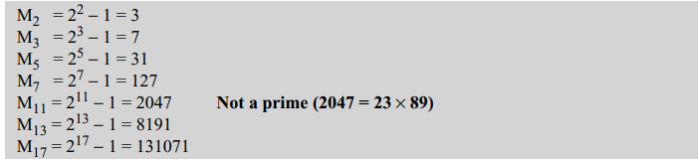
Generating Primes
Mersenne and Fermat formula
Mersenne numbers, can enumerate all primes for a number p
M_{p} = 2^{p} − 1
Mersenne number may or may not be a prime.

Slide 69
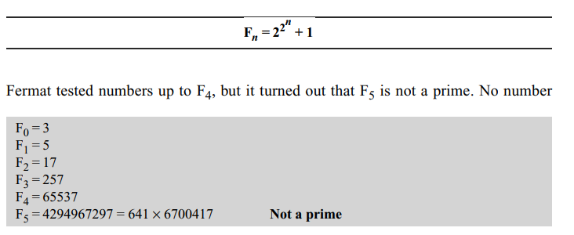
Fermat Primes

Slide 70
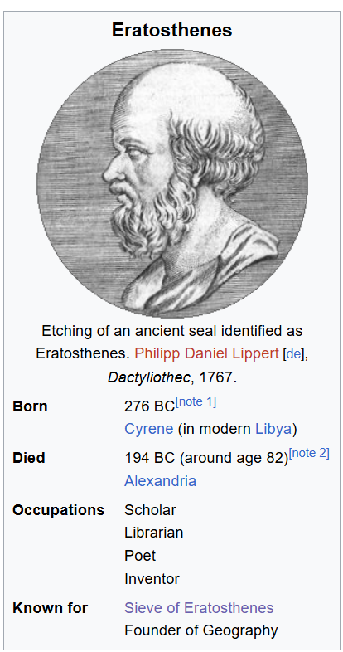
Generating Primes-Sieve of Eratosthenes
Start with a list of numbers from 2 to n, all marked as potential primes.
The first prime is 2 — mark all multiples of 2 (except 2 itself) as composite.
Move to the next unmarked number (3) — mark all its multiples as composite.
Repeat until the current number exceeds √n.
Remaining unmarked numbers are primes.
Why Stop at √n?
If a number x is composite, it must have at least one factor ≤ √n. Once all factors ≤ √n are removed, no larger composite can remain.

Slide 71
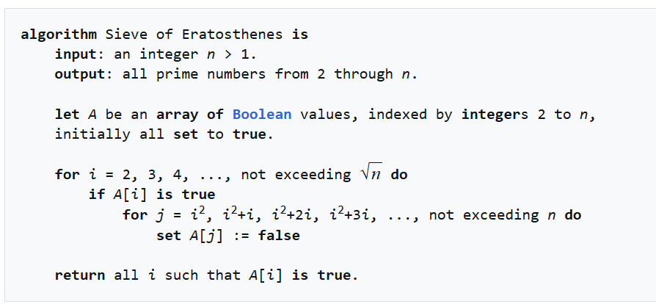
Sieve of Eratosthenes

Slide 72
Strengths
Complexity:
Time: O(n log log n)
Space: O(n)
Strength
Simple to implement
Very fast for small to mid-size n
Weakness
Space complexity
Use Case:
When generating all primes ≤ 10⁷
Ideal for competitive programming and educational use

Slide 73
Sieve of Atkin
Instead of crossing out multiples, it uses mathematical patterns to identify potential primes based on quadratic forms:
Any prime > 3 is of the form 6k ± 1.
But Sieve of Atkin refines this further with mod 12 because:
All primes > 3 are in 1, 5, 7, or 11 mod 12.
Mod 12 works because LCM of the first few primes (2, 3) is 6, and multiplying by 2 (for handling even spacing in quadratic forms) leads to 12.
This helps skip obvious composites early.

Slide 74
The Quadratic Rules
It flips the primality state for numbers satisfying:
n = 4x² + y² → toggle if n % 12 is 1 or 5
n = 3x² + y² → toggle if n % 12 is 7
n = 3x² - y² → toggle if x > y and n % 12 is 11
Final Step
After marking, remove all perfect squares because quadratic flipping can falsely mark them.

Slide 75
Let n = 30.
Initialize all is_prime[i] = False for 0 ≤ i ≤ n.
For each x and y with 1 ≤ x, y ≤ √n:
Compute:
n = 4x² + y², mark if n mod 12 in {1, 5}
n = 3x² + y², mark if n mod 12 == 7
n = 3x² − y² (if x > y), mark if n mod 12 == 11
If above condition met → flip boolean status (True ↔ False)
Eliminate all squares:
For each i ≤ √n:
If is_prime[i], mark all multiples of i² as False
Include 2, 3 manually in output.

Slide 76
Complexity:
Time: O(n / log log n)
Space: O(n)
Strength
Slightly faster than Eratosthenes for large n
Fewer operations on composites
Weakness:
Complex to implement
Use Case:
Efficient when n > 10⁷ or 10⁸
Useful in mathematical research or performance-sensitive scenarios

Slide 77
Segmented Sieve
Generates primes in a range [L, R] without storing all numbers up to R.
Steps
Generate all primes up to √R using a normal Sieve of Eratosthenes.
For each prime p in that list, mark multiples of p in the range [L, R] as composite.
Remaining unmarked numbers in [L, R] are primes.

Slide 78
Segmented Sieve
Why Only Up to √R?
Any composite number in [L, R] must have a factor ≤ √R.
Primes larger than √R can appear in [L, R], but they cannot generate composites within that range (other than themselves multiplied by 1).
E.g.
If R = 120, √R ≈ 10.95 → checking primes only up to 10 works(2, 3, 5, 7).

Slide 79
Let’s find primes in range [L=100, R=120].
Compute base_primes = primes up to √120 = 10 using Eratosthenes: → base_primes = [2, 3, 5, 7]
Create array is_prime_segment = [True] * (R - L + 1)
For each p in base_primes:
Compute start = max(p*p, ceil(L/p)*p)
Mark start, start + p, …, R as False in is_prime_segment
Remaining True values in is_prime_segment are the primes in [L, R]

Slide 80
Complexity:
Time: O((R−L+1) log log R)
Space: O(R−L+1)
Strength
Memory-efficient for large ranges
Works well when R is huge (e.g. 10¹²)
Weakness
Needs primes up to √R
Complex to impalement
Use Case:
Generate primes in range [10⁹, 10⁹+10⁶]
Large-scale computations or number-theoretic simulations

Slide 81
Prime generation summary
Feature | Eratosthenes | Atkin (mod 12) | Segmented Sieve (√R)
Method | Cross out multiples | Mathematical toggling rules | Range sieving with base primes
Math Trick | √n limit for marking | Prime residues mod 12 | Only primes ≤ √R needed
Benefit | Simple and cache-friendly | Skips many composites early | Memory efficient for large R

Slide 82
Why Primality Testing is Important in Applied Cryptography
Public-key cryptography depends on large prime numbers — often hundreds or thousands of bits long.
Security relies on:
Generating large random numbers
Quickly checking if they are prime
Avoiding composites that weaken encryption
E.g. Without fast primality tests, RSA key generation would be impractically slow.
Example: For a 2048-bit RSA key, we must test random ~2048-bit candidates until we find two large primes.

Slide 83
Primality testing
Miller-Rabin, Fermat’s test, square root test – Probabilistic
AKS(Agrawal, Kayal, and Saxena) algorithm – deterministic
Recommended Algorithm

Slide 84
Probabilistic Algorithms for primality testing
A probabilistic algorithm returns either a prime or a composite based on the following rules:
If the integer to be tested is actually a prime, the algorithm definitely returns a prime.
If the integer to be tested is actually a composite, it returns a composite with probability 1− ε, but it may return a prime with the probability ε.
The probability of mistake can be improved by :
running the algorithm more than once with different parameters or,
using different methods.
If the algorithm is run m times, the probability of error may reduce to ε^{m}.

Slide 85
Fermat’s Primality Test – Probabilistic
Fermat's Little Theorem: If p is prime, and some number ‘a’ is coprime to p, then: a^{(p-1)} ≡ 1 (mod p)
Algorithm, for some number ‘n’:
Choose random a in the range [2, n-2].
Compute a^{(n-1)} mod n.
If answer is not 1 → then n is composite.
Repeat for several a values.

Slide 86
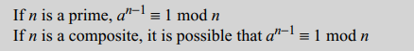
Fermat Test
Prime no property states that : If n is a prime, then
a^{n−1} ≡ 1 mod n
i.e. if n is a prime, the congruence holds.
But if the congruence holds, n is not necessarily a prime.
The integer can be a prime or composite
So, a prime passes the Fermat test;
And a composite may pass the Fermat test with probability ε.

Slide 87
Reading: Fermat Test
Since 5 is prime,
2⁴ ≡ 1 (mod 5) [or 2⁴%5 = 1],
3⁴ ≡ 1 (mod 5) …. [2, n-2] range
Since 7 is prime,
2⁶ ≡ 1 (mod 7)
3⁶ ≡ 1 (mod 7)
4⁶ ≡ 1 (mod 7)
5⁶ ≡ 1 (mod 7)…. [2, n-2] range
Answer remains same with diff values of ‘a’

Slide 88
Fermat’s Test
Does the number 561 pass the Fermat test? Solution :
Use base a= 2
2^{561–1} ≡ 1 mod 561
The number passes the Fermat test, but it is not a prime, because 561 = 33 × 17

Slide 89
Fermat Test
Example: n=341
341=11×31 (so it’s composite).
Pick base a=2 with gcd⁡(2,341)=1.
Compute: 2³⁴⁰ mod 341 = 1 mod 340
2340≡1(mod341)
so Fermat’s test with base a=2 would label 341 as “probably prime,”
Numbers like this are called Fermat pseudoprimes to base 2.
Even stronger, numbers such as 561 = 3×11×17—Carmichael numbers—pass the Fermat test for every base a that is coprime to n.

Slide 90
Square Root Test
Idea:
"Try dividing nnn by all numbers up to its square root. If none divide, it’s prime."
A number n is composite if it has a factor other than 1 and itself. If n=a×b, then at least one of a or b must be ≤ √n.
So, to test if n is prime, you only need to check divisibility up to √n
Very easy to understand and implement.
Works perfectly for small numbers.
Weaknesses
Very slow for large numbers (e.g., testing a 200-digit number is impossible).
Not suitable for cryptography.

Slide 91
Square Root Test
In modular arithmetic, if n is a prime, then square root is either +1 or −1.
If n is composite, the square root is +1 or −1, but there may be other roots.
This is known as the square root primality test.
Note : in modular arithmetic, −1 means (n −1).
If n is a prime, √ 1 mod n = ±1.
If n is a composite, √ 1 mod n = ±1 and possibly other values

Slide 92
Square Root Test
Steps
If n≤1, it is not prime.
if (n % 2 ==0 && n≠2), then n is composite.
Check divisibility by odd numbers from 3 up to √n.
If any divides evenly → composite.
If none divide → prime.

Slide 93
Example 1: Check if 37 is prime
√37 ≈ 6.08 → check divisibility only up to 6.
Divisors to test: 2, 3, 5.
37 % 2 ≠ 0, 37 % 3 ≠ 0, 37 % 5 ≠ 0 → Prime.
Example 2: Check if 91 is prime
√91 ≈ 9.53 → check up to 9.
Test 2, 3, 5, 7.
91 % 7 = 0 → divisible → Composite (91 = 7 × 13).

Slide 94
Reading: Square Root Test
Although this test can tell us if a number is composite, it is difficult to do the testing.
Given a number n, all numbers less than n (except 1 and n −1) must be squared to be sure that none of them is 1.
This test can be used for a number (not +1 or −1) that when squared in modulus n has the value 1. T

Slide 95
Square Root Test
Strengths
Simple and exact.
Works for any n.
Weaknesses
O(√n) time → hopeless for large numbers in cryptography.

Slide 96
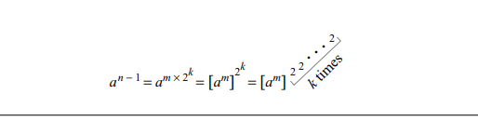
Miller-Rabin Test
Combines the Fermat test and the square root test to find a strong pseudoprime (a prime with a very high probability).
Uses (n − 1) as the product of an odd number m and a power of 2:
n − 1 = m × 2^{k}
Base ‘a’ in Fermat’s test is written as:

Slide 97
Reading: Miller-Rabin Test
i.e. instead of calculating a n−1 (mod n) in one step, it can be done in k + 1 steps.
Benefit?
The square root test can be performed in each step.
If the square root test fails, stop and declare n as a composite number.
Each step assures that the Fermat test is passed and the square root test is satisfied between all pairs of adjacent steps, if applicable (if the result is 1).
The Miller-Rabin test needs from step 0 to step k − 1.

Slide 98
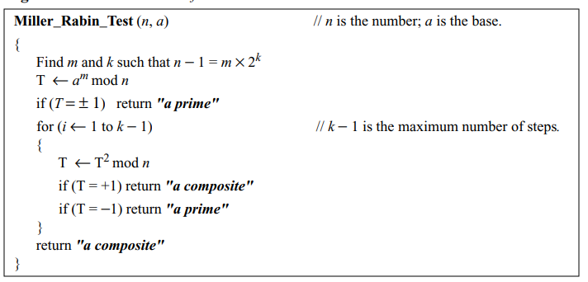
Reading: Miller-Rabin Test

Slide 99
Miller-Rabbin Test
Example : check primality of number 27 using Miller-Rabbin test
Solution:
express n − 1 as the product of an odd number m and a power of 2 that satisfies:
n − 1 = m × 2^{k}
So assume expression as: 27 − 1 = 13 × 2¹ ,
i.e. m = 13, k = 1, and a = 2.
As k − 1 = 0,
we should do only the initialization step:
T = 2¹³ mod 27 = 11 mod 27.
However, because the algorithm never enters the loop, it returns a composite.

Slide 100
Reading: Miller-Rabin test Example
Example : if the number 561 pass the Miller-Rabin test?
Solution: Assume base =2.
As per Miller-Rabin test , express n − 1 as the product of an odd number m and a power of 2 that satisfies:
n − 1 = m × 2^{k}
So, let 561 − 1 = 35 × 2⁴ ,
i.e m = 35, k = 4, and a = 2

Slide 101
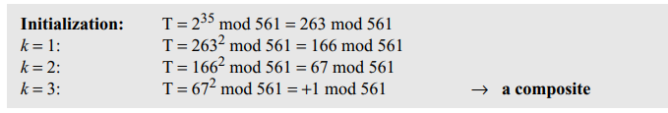
Reading:

Slide 102
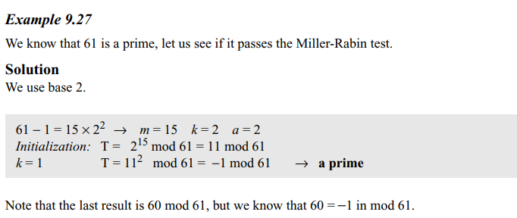
Reading:

Slide 103
Rabin-Miller test
Strengths
Very reliable in practice with a few rounds.
Extremely fast for large n.
Weaknesses
Still probabilistic (error rate ~4⁻ᵏ for k rounds).
Slightly more complex than Fermat.

Slide 104
Deterministic primality testing Algorithms
These algorithms accept an integer and always outputs a prime or a composite.
Until recently, all deterministic algorithms were so inefficient at finding larger primes that they were considered infeasible.
But newer algorithm looks more promising
Algorithms
Divisibility Algorithm
AKS(Agrawal, Kayal, and Saxena) Algorithm

Slide 105
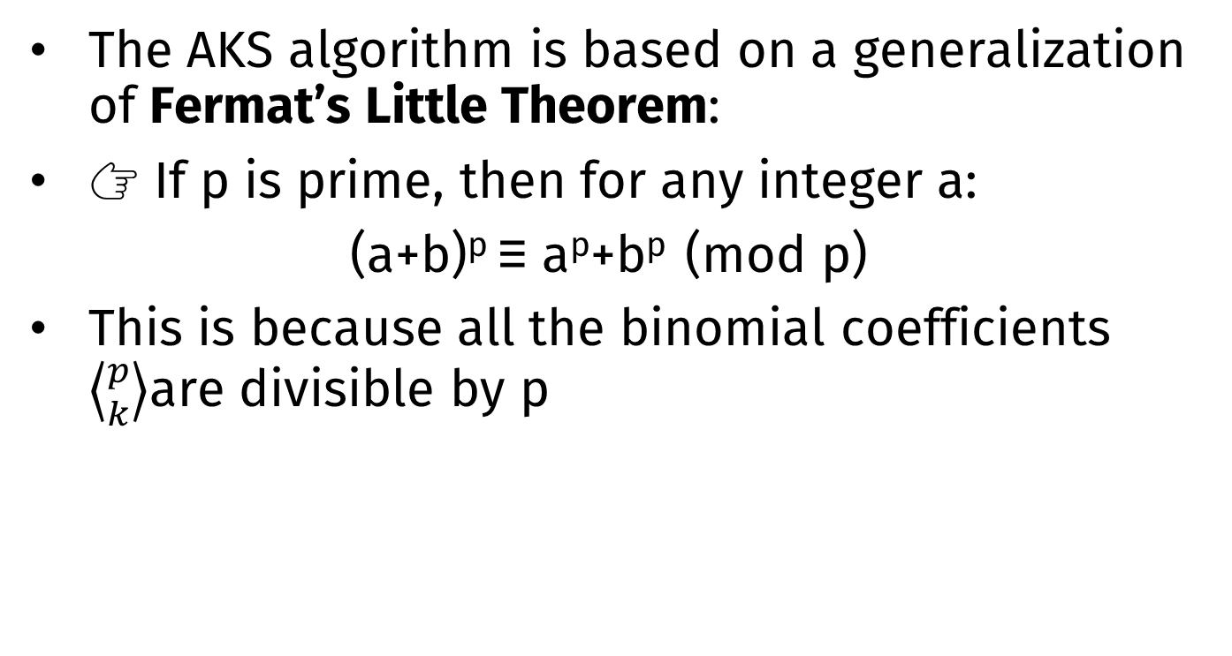
AKS Algorithm
The AKS algorithm is based on a generalization of Fermat’s Little Theorem:
👉 If p is prime, then for any integer a:
(a+b)^{p} ≡ a^{p}+b^{p} (mod p)
This is because all the binomial coefficients $\left\langle {p \atop k}\right\rangle$are divisible by p

Slide 106
AKS Algorithm
Mathematical Basis
If n is prime ⇔ (x + a)^{n} ≡ x^{n} + a (mod n) for all a coprime to n.
Algorithm Outline
Check if n is a perfect power.
Find the smallest r such that ord_r(n) > log²n.
Check gcd(a, n) for a ≤ r — if > 1 → composite.
For a = 1 to ⌊√φ(r) log n⌋:
Check if (x + a)^{n} ≡ x^{n} + a (mod x^{r} − 1, n) fails.
If all pass → prime.
E.g n = 5, (x+1)⁵ mod 5 = x⁵ + 1 → matches property → Prime.

Slide 107
How AKS Works?
Check if n is a perfect power (like n=a^{b}, with b>1). If yes, then n composite.
Find a suitable r (a small number) such that the order of n mod r is large enough.
Check GCD condition for r such that, For all a≤r, compute gcd⁡(a,n)
If any nontrivial divisor found, n is composite.
4. Main Congruence Test
Verify for several a, up to (√ϕ(r)log⁡n) :
(X+a)^{n} ≡X^{n} + a (mod(X^{r}−1), n)
If this holds for all tested a, then n is prime.
If not, n is composite.
5. If passes all tests → PRIME.

Slide 108
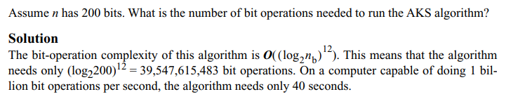
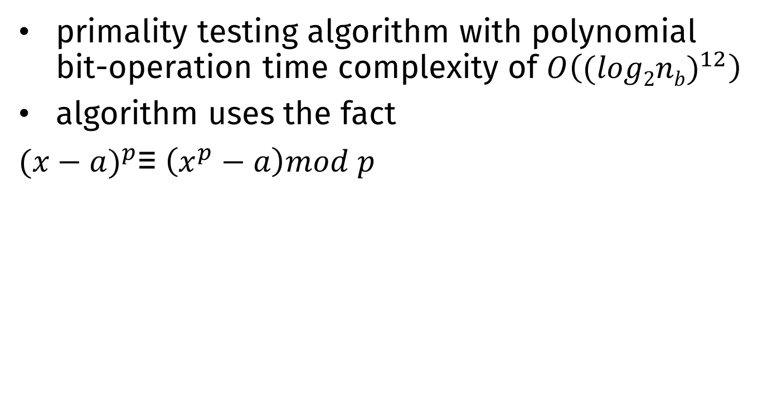
Reading: AKS Deterministic primality testing Algorithm
primality testing algorithm with polynomial bit-operation time complexity of $O\left({(log2nb)}^{12}\right)$
algorithm uses the fact
${(x−a)}^{p}$≡ $\left(x^{p}−a\right)mod p$

Slide 109
AKS Algorithm
Strengths
Deterministic and polynomial time.
First breakthrough in showing primality testing in P-time.
Weaknesses
Very slow in practice compared to Miller–Rabin.
Used mainly for theoretical proofs.

Slide 110
Reading: Recommended Primality Test
One of the most popular primality test is a combination of the divisibility test and the Miller-Rabin test.
Recommended steps:
Choose an odd integer, because all even integers (except 2) are definitely composites.
Do some trivial divisibility tests on some known primes such as 3, 5, 7, 11, 13, be sure that its really a composite. If the number passes all of these tests, move to the next step. If the number fails any of these tests, go back to step 1 and choose another odd number.
Choose a set of bases for testing. A large set of bases is preferable.
Do Miller-Rabin tests on each of the bases. If any of them fails, go back to step 1 and choose another odd number. If the test passes for all bases, declare the number a strong pseudoprime.

Slide 111
Factorization

Slide 112
Fundamental Theorem of Arithmetic
“Any positive integer greater than one can be written uniquely in the following prime factorization form where p₁, p₂,…, p_{k} are primes and e₁, e₂, …, e_{k} are positive integers”
n = p₁^{e1} × p₂^{e2} × … × p_{k}^{ek}

Slide 113
Applications of factorization
Calculation of the greatest common divisor
Calculation of the least common multiplier
Cryptographic and cryptanalytics solutions in cryptology

Slide 114
Greatest Common Divisor
Fact 1: gcd (a, 0) = a
Fact 2: gcd (a, b) = gcd (b, r), where r is the remainder of dividing a by b
Fact 3: gcd(a,b)=1 then a and b are co-prime or relatively prime

Slide 115
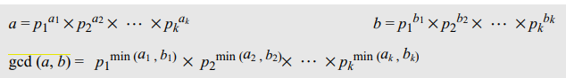
Reading: Factorization
The Euclidean algorithm can give value of gcd(a,b)
It Can also be computed if the factorization of a and b is known

Slide 116
Reading: Least Common Multiplier
The least common multiplier, lcm (a, b), is the smallest integer that is a multiple of both a and b.
Using factorization, we also find lcm (a, b).
a = p1^{a1} × p2^{a2} × … × pk^{ak}
b = p1^{b1} × p2^{b2} × … × pk^{bk}
Then,
lcm(a,b) =p1^{max (a1,b1)}×p2^{max(a2,b2)} × … ×pk^{max(ak,bk)}

Slide 117
Reading: Relation between GCD and LCM
lcm (a, b) × gcd (a, b) = a × b

Slide 118
Factorization Methods
No such perfect algorithm for factorization
There are several algorithms that can factor a number
None are capable of factoring a very large number in a reasonable amount of time

Slide 119
Factorization Methods
Trial Division Method
Fermat Method
Pollard p – 1 Method
Pollard rho Method
Study Fermat’s method and Pollard rho method

Slide 120
Trial Division Method
The simplest and least efficient algorithm
Try all the positive integers, starting with 2, to find one that divides n.
if n is composite, then it will have a prime p ≤ √n
The outer loop finds unique factors; the inner loop finds duplicates of a factor.
For example, 2⁴ = 2³× 2. The outer loop finds the factors 2 and 3.
The inner loop finds that 2 is a multiple factor

Slide 121
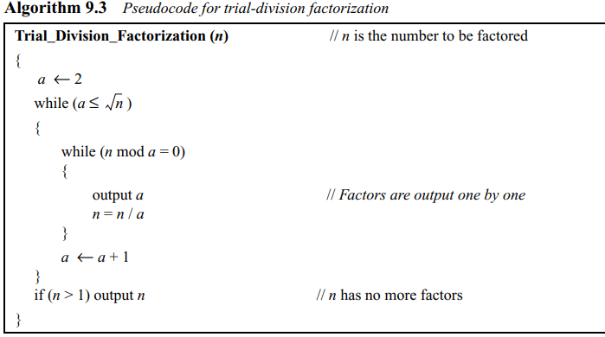
Trial Division algorithm
The outer loop finds unique factors;
the inner loop finds duplicates of a factor.

Slide 122
Trial Division Method
For example,
N=24
while (a ≤√24 ) i.e. a = 2,3,4 ➔ outer loop
while (n mod a = 0) (true for 2,3,4 i.e. all numbers) ➔ inner loop gives all factors
Complexity
The trial-division method is normally good if n < 2¹⁰,
but it is very inefficient and infeasible for factoring large integers.
The complexity of the algorithm is exponential.

Slide 123
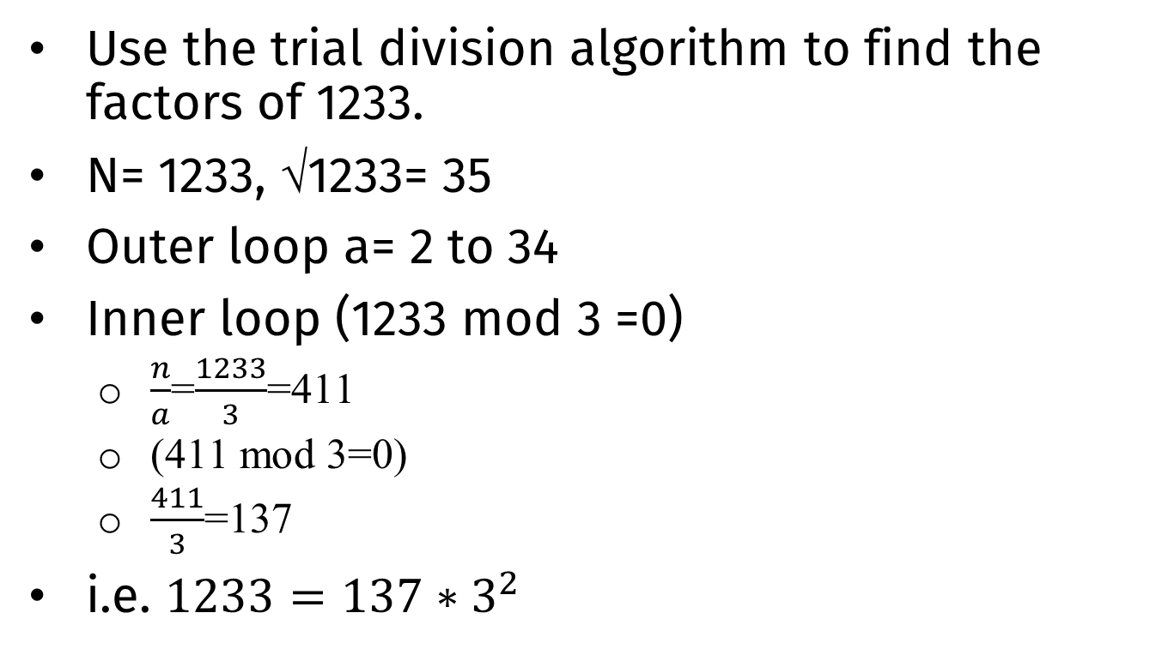
Trial Division Method
Use the trial division algorithm to find the factors of 1233.
N= 1233, √1233= 35
Outer loop a= 2 to 34
Inner loop (1233 mod 3 =0)
$\frac{n}{a}$=$\frac{1233}{3}$=411
(411 mod 3=0)
$\frac{411}{3}$=137
i.e. $1233={137∗3}^{2}$

Slide 124
Use the trial division algorithm to find the factors of 1523357784.
Solution
1523357784 = 2³ × 3² × 13 × 37 × 43987

Slide 125
Fermat Method
The Fermat factorization method divides a number n into two positive integers a and b (not necessarily a prime) so that n = a × b.
It is based on the fact that if we can find x and y such that n = x² − y² , then we have
n = (x² − y²⁾ = a × b
with a = (x + y)
and b = (x − y)

Slide 126
Fermat Method
Finds two integers a and b close to each other (a ≈ b).
It starts with the smallest integer greater than x = √n and
Searches for another integer y that holds the relation y² = x² − n
in each iteration, result of y= x² − n has to be a perfect square.
If such a value for y is found, calculate a and b and break from the loop.
If such y is not found, do another iteration.

Slide 127
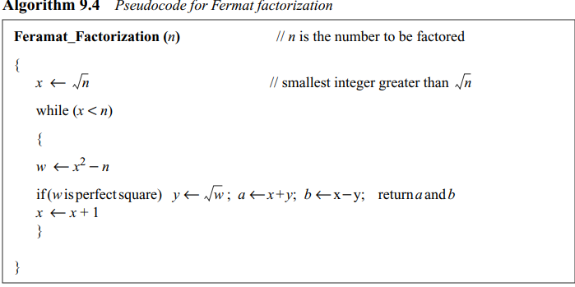
Fermat Method

Slide 128
Fermat Method
The method does not necessarily find a prime factorization;
the algorithm must be recursively repeated for each value a and b until the prime factors are found.
Complexity :
The complexity of the Fermat method is close to subexponential

Slide 129
Pollard p – 1 Method
Works on a predefined bound value B
Finds a prime factor p of a number based on the condition that p−1 has no factor larger than B.
p = gcd (2^{B!} − 1, n)
P is a prime number
P-1 has no factor greater than bound B

Slide 130
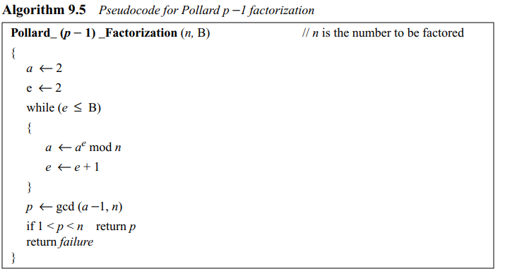
Pollard p – 1 Method

Slide 131
Pollard p – 1 Method
Example: n=1233, assume b=4
Initialization a=2, e=2
While (e<=B=4) i.e.
a=a^{e} mod n = 2² mod 1233= 4 ; e=3
a=4³ mod 1233 = 64 ; e= 4
A= 64⁴ mod 1233 = 1018; e =5 end loop
P= gcd(1233,1017(p-1)) =9
9 is factor, hence 1233=9*137
(p-1) has no factor is greater than 4
i.e. 8= 2² x 2

Slide 132
Pollard p – 1 Method
Use the Pollard p − 1 method to find a factor of 57247159 with the bound B = 8
Solution: p = 421.
So, 57247159 = 421 × 135979.
Note that 421 is a prime and p − 1 has no factor greater than 8 (421 − 1 = 2² × 3 × 5 × 7).

Slide 133
Pollard rho Method
Pollard rho factorization method is based on :
Assume that there are two integers, x1 and x2, such that p divides x1 − x2, but n does not.
It can be proven that p = gcd (x1 − x2, n). Because p divides x1 − x2,
it can be written as x1 − x2 = q × p.
But because n does not divide x1− x2, it is obvious that q does not divide n.
This means that gcd (x1 − x2, n) is either 1 or a factor of n.

Slide 134
Pollard rho Method
The algorithm repeatedly selects x1 and x2 until it finds an appropriate pair.
Choose x1, a small random integer called the seed.
Use a function to calculate x2 such that n does not divide x1 − x2.
A function that may be used here is
x2 = f (x1) = x1² + a (a is normally = 1).
3. Calculate gcd (x1 − x2, n). If it is not 1, the result is a factor of n; stop.
If it is 1, return to step 1 and repeat the process with x2. calculate x3 and so on.
Listing the values of x’s using the Pollard rho algorithm, its obsrved that that the values are eventually repeated, creating a shape similar to the Greek letter rho (ρ)

Slide 135
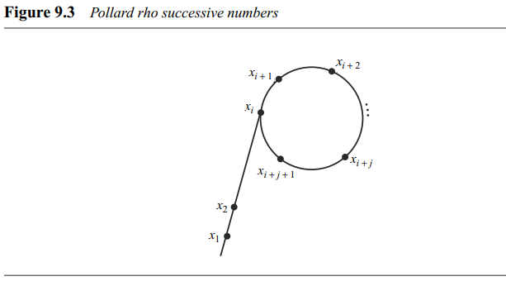
Pollard rho Method

Slide 136
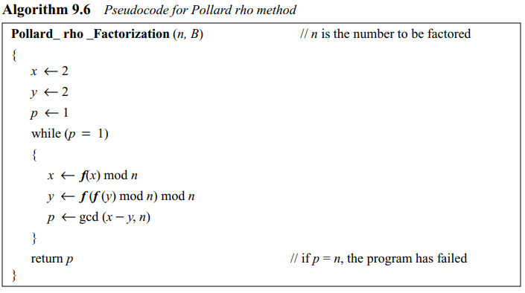
Pollard rho Method

Slide 137
Pollard rho Method
Complexity
The method requires √p arithmetic operations.
However, because p is expected to be smaller or equal to √n, expected number of arithmetic operations = n^{1/4}.
This means that the bit-operation complexity is O(2^{nb/4} ), i.e. exponential.

Slide 138
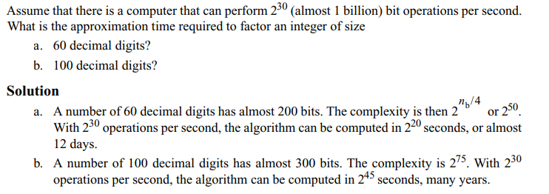
Pollard rho Method

Slide 139
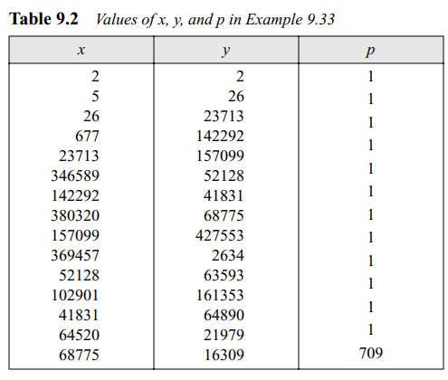
Pollard rho Method
Example: Factorize 434617 using Pollard rho method
Ans: 709
i.e.
434617= 709*613

Slide 140
Reading: Discrete Logarithm

Slide 141
The idea of Discrete Logarithm
Discrete Logarithm problem is to compute x given g^{x} (mod p).
The problem is hard for a large prime p

Slide 142
The idea of Discrete Logarithm
The group G =<Z_{n}*,X> has several interesting properties:
Its elements include all integers from 1 to p − 1.
It always has primitive roots.
It is cyclic.
The elements can be created using g^{x} where x is an integer from 1 to φ(n) = p − 1.
The primitive roots can be thought as the base of logarithm.
If the group has k primitive roots, calculations can be done in k different bases.
Given x = log_{g}y for any element y in the set, there is another element x that is the log of y in base g.
This type of logarithm is called discrete logarithm.
A discrete logarithm Lg to shows that the base is g (the modulus is understood).

Slide 143
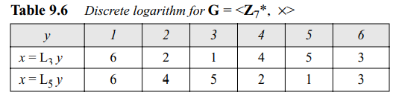
Modular Logarithm Using Discrete Logs
solve problems to find x where y = a^{x} (mod n) and y is given. ➔ x= log_{a} y
Solution : use a table for each Zp∗ and different bases. E.g. solve for Z₇∗
Zp∗ has two primitive roots= 3 and 5

Slide 144
Example: Discrete logarithms
Find x where 6 ≡ 5^{x} (mod 7)
Solution: use the tabulation of the discrete logarithm for Z₇∗
6 ≡ 5^{x} mod 7 → x = L₅6 mod 7 = 3 mod 7

Slide 145
Example
Find x where a 4 ≡ 3^{x} (mod 7)
Solution: use the tabulation of the discrete logarithm for Z₇∗
4 ≡ 3^{x} mod 7 → x = L₃4 mod 7 = 4 mod 7

Slide 146
Discrete Logarithm solution
Let’s revisit the discrete logarithm and examples at the end of slides.
What all we need for computation of discrete logarithm solution?
Finite groups,
order of group,
order of elements
Primitive roots
Cyclic groups

Slide 147
Discrete Logarithm solution
Borrows concepts from Finite Multiplicative Group
G =<Z_{n}*,X>
operation is multiplication
set Zn* contains integers from 1 to n−1 that are relatively prime to n;
the identity element is e = 1.
Note that when the modulus of the group is a prime, we have G =<Z_{p}*,X>

Slide 148
Order of a finite group
order of a finite group denoted as |G|,
i.e the number of elements in the group G.
As per number theory: |G| =φ(n)
φ(n)=φ(p)*φ(q) where p and q are prime factors.
E.g. order of group G = =<Z₁₅*,X>?
|G|= φ(15) = φ(5)*φ(3) = 8

Slide 149
Order of an Element
In finite group G =<Z_{n}*,X>
The order of an element, ord(a), is the smallest integer i such that a^{i} ≡ e (mod n).
The identity element e is 1

Slide 150
Example:
Find the order of all elements in G = <Z₁₀*,X>
φ(10) =φ(5)*φ(2)=4 ={1,3,7,9}
As per Lagrange theorem: order of an element divides the order of the group
So, integers that divide 4 are 1, 2, and 4,
i.e. check only these powers to find the order of the element
1¹ ≡ 1 mod (10) → ord(1) = 1.
3¹ ≡ 3 mod (10); 3² ≡ 9 mod (10); 3⁴ ≡ 1 mod (10) → ord(3) = 4.
7¹ ≡ 7 mod (10); 7² ≡ 9 mod (10); 7⁴ ≡ 1 mod (10) → ord(7) = 4.
9¹ ≡ 9 mod (10); 9² ≡ 1 mod (10) → ord(9) = 2.

Slide 151
Euler’s Theorem and finite groups
As per Euler’s theorem if a is the member of
G =<Z_{n}*,X> , then a^{φ(n)} = 1 mod n
i.e. relationship a^{i} ≡ 1 (mod n) holds when
i = φ(n)

Slide 152
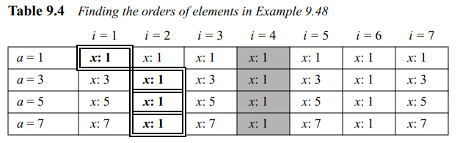
Euler’s Theorem and finite groups
shows the result of a^{i} ≡ x (mod 8) for the group G =<Z_{n}*,X> .
Note that φ(8) = 4. elements ={1, 3, 5, 7}.

Slide 153
Euler’s Theorem and finite groups
From the table:
When i = φ(8) = 4, the result is x = 1 for every a.
Value of x can be 1 for more values of I
Solutions:
ord(1) = 1,
ord(3) = 2,
ord(5) = 2, and
ord(7) = 2.

Slide 154
Primitive Roots
In the group G =<Z_{n}*,X> , when the order of an element is the same as φ(n), that element is called the primitive root of the group.
E.g. G =<Z₈*,X>
Z₈* elements={1,3,5,7}
ord(1) = 1, ord(3) = 2, ord(5) = 2, and ord(7) = 2
i.e. no element has the order equal to φ(8) = 4.
The order of elements are all smaller than 4.
Thus, G Has no primitive roots

Slide 155
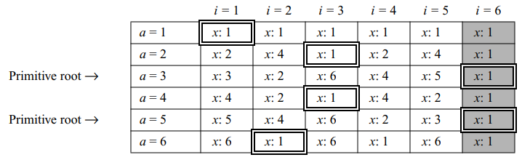
Primitive Roots
E.g. G =<Z₇*,X>
Z7* elements={1,2,3,4,5,6}
φ(7) = 6
ord(1) = 1, ord(2) = 3, ord(3) = 6, ord(4) = 3, ord(5) = 6, and ord(6) = 1.
So, group has only two primitive roots: 3 and 5 as ord(3)=ord(5)= φ(7)

Slide 156
Primitive Roots
The group G =<Z_{n}*,X> has primitive roots only if n is 2, 4, p^{t} , or 2p^{t} .
If a group has a primitive root, then it normally has several of them.
The number of primitive roots are calculated as φ(φ(n)).
E.g. the number of primitive roots G =<Z₁₇*,X> are: φ(φ(17)) = φ(16)=8#
#cant be divided in prime factors.
Z₁₆*={1,3,5,7,9,11,13,15}

Slide 157
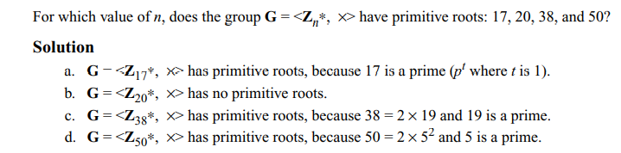
Primitive Roots
Given: The group G =<Z_{n}*,X> has primitive roots only if n is 2, 4, p^{t} , or 2p^{t} .

Slide 158
Challenges and issues with Primitive Roots
Given an element a and the group G =<Z_{n}*,X> , how can we find out whether a is a primitive root?
Computation of φ(n) is as difficult as factorization of n.
Checking whether ord(a) = φ(n).
Given a group G =<Z_{n}*,X> how to check all primitive roots of G?
This is more difficult than the first task because we need to check if ord(a) = φ(n) for all elements of the group.
Given a group G =<Z_{n}*,X> , how to select a primitive root of G?
Cryptography needs at least one primitive root in the given group.
However value of n is chosen by the user and user knows the value of φ(n).
The user has to try several elements until they find the first one.

Slide 159
Cyclic Groups
if the group G =<Z_{n}*,X> has primitive roots, it is cyclic.
Each primitive root is a generator and can be used to create the whole set.
In other words, if g is a primitive root in the group, we can generate the set Zn* as
Z_{n}∗ = {g¹ , g² , g³ , …, g^{φ(n)} }
The group G =<Z_{n}*,X> is a cyclic group if it has primitive roots.
The group G =<Z_{p}*,X> is always cyclic. (Prime no property)

Slide 160
Example: Cyclic group
The group G =<Z₁₀*,X> has two primitive roots because φ(10) = 4 and φ(φ(10)) = 2.
Primitive roots= 3,7.
using each primitive root, generate a group of Z₁₀*.
Using g=3 ➔g¹ mod 10 = 3 g² mod 10 = 9 g³ mod 10 = 7 g⁴ mod 10 = 1
using g=7➔ g¹ mod 10 = 7 g² mod 10 = 9 g³ mod 10 = 3 g⁴ mod 10 = 1
Cyclic group

Slide 161
Discrete Logarithm….. again
Discrete Logarithm problem is to compute x given g^{x} (mod p).
The problem is hard for a large prime p

Slide 162
The idea of Discrete Logarithm
The group G =<Z_{n}*,X> has several interesting properties:
Its elements include all integers from 1 to p − 1.
It always has primitive roots.
It is cyclic.
The elements can be created using g^{x} where x is an integer from 1 to φ(n) = p − 1.
The primitive roots can be thought as the base of logarithm.
If the group has k primitive roots, calculations can be done in k different bases.
Given x = log_{g}y for any element y in the set, there is another element x that is the log of y in base g.
This type of logarithm is called discrete logarithm.
A discrete logarithm Lg to shows that the base is g (the modulus is understood).

Slide 163
Modular Logarithm Using Discrete Logs
solve problems to find x where y = a^{x} (mod n) and y is given. ➔ x= log_{a} y
Solution : use a table for each Zp∗ and different bases. E.g. solve for Z₇∗
Zp∗ has two primitive roots= 3 and 5

Slide 164
Example: Discrete logarithms
Find x where 6 ≡ 5^{x} (mod 7)
Solution: use the tabulation of the discrete logarithm for Z₇∗
6 ≡ 5^{x} mod 7 → x = L₅6 mod 7 = 3 mod 7

Slide 165
Find x where a 4 ≡ 3^{x} (mod 7)
Solution: use the tabulation of the discrete logarithm for Z₇∗
4 ≡ 3^{x} mod 7 → x = L₃4 mod 7 = 4 mod 7

Slide 166
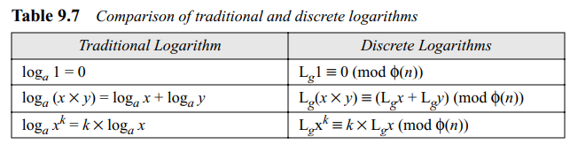
Traditional Vs Discrete Logarithm
The discrete logarithm problem has the same complexity as the factorization problem

Slide 167
Applications of discrete logarithms
fundamental to a number of public-key algorithms,
E.g. Diffie-Hellman key exchange and the digital signature algorithm (DSA).
Currently, the best-known algorithm for computing discrete logarithms in Z∗p (for p prime) is the general number field sieve(NFS)

Slide 168
Questions?

